Slide 1


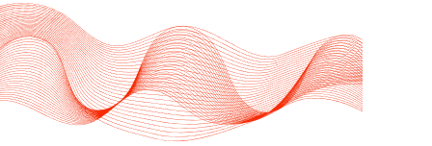
UNIVERSITY COLLEGE CORK
VISUALIZATION OF GLOBAL TERRORISM DATA
Presented by:
Shujie Fan
Notes:
As the name implies, the main goal of my project is to visualize global terrorism activities using data from a standard database.

Slide 2

BACKGROUND
Terrorism as a means of violence can be traced back to ancient societies, but its nature and scope have undergone significant changes in modern times. In recent years, global terrorism has shown new trends, such as the shift in geographical distribution and the increase in "lone wolf" attacks.
Notes:
Before we dive into my project, I’d like to reach a concensus about terrorism. Terrorism has long been a tool of violence, with its roots in ancient societies. However, in modern times, the nature and scope of terrorism have evolved.

Slide 3
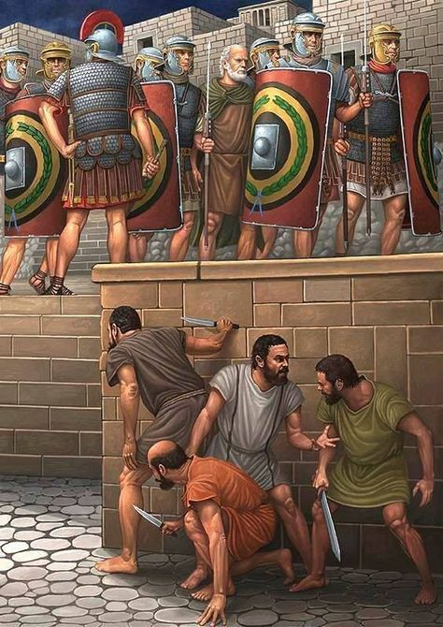
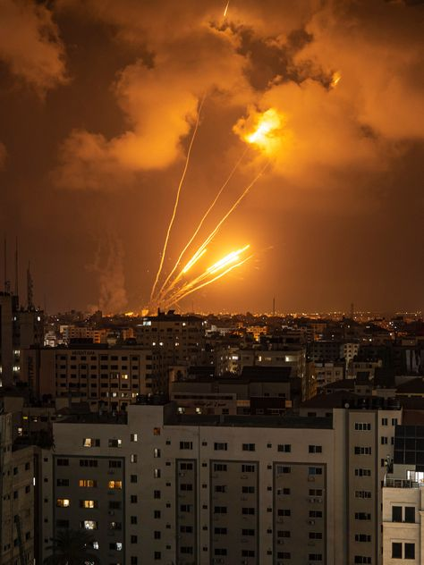
The Sicarii in ancient Rome were a well-known Jewish extremist group that used daggers to assassinate Roman officials and pro-Roman elements among their fellow Jews in order to resist the rule of the Roman Empire.
On October 7, 2023, Hamas and some other Palestinian armed groups launched a largescale armed attack from the Gaza Strip. The background of this attack is complex. It involves many different factors, such as the long-standing Israeli-Palestinian conflict.
Notes:
A historical example includes the Sicarii, a Jewish extremist group in ancient Rome. And more recently, on October 7, 2023, we witnessed a large-scale armed attack launched by Hamas and other Palestinian groups from Gaza. This shows that terrorism remains a pressing issue today, with multiple underlying factors at play, such as the long-standing Israeli-Palestinian conflict.

Slide 4




PURPOSE
This study aims to quantitatively analyze and visualize global terrorist activities based on the Global Terrorism Database (GTD).
Data Collection
Data Processing
Data Visualization
Develop
an interactive
platform
Notes:
The purpose of this study is to provide a quantitative analysis and visualization of global terrorist activities. This is achieved through the Global Terrorism Database, or GTD for short. In this project, I focus on data collection, data processing, and data visualization, and develop an interactive platform that allows users to easily explore this data

Slide 5
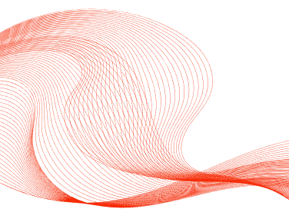
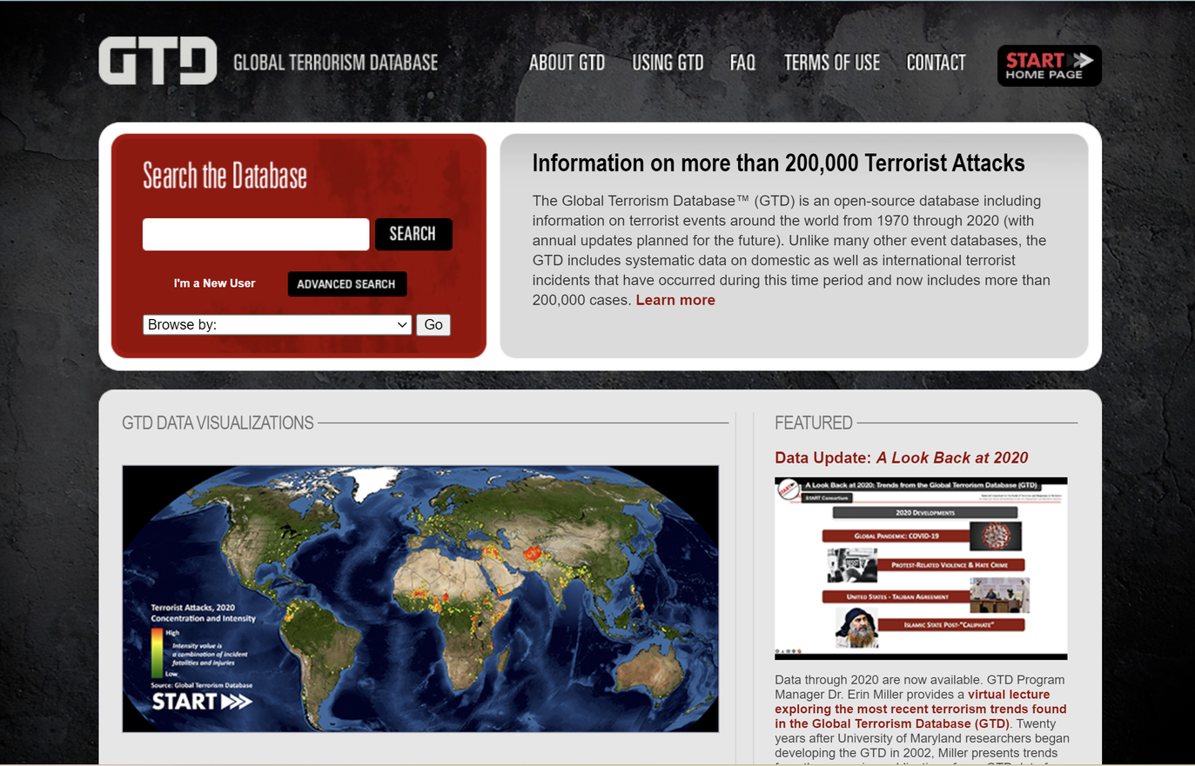
DATA COLLECTION
The data for this project comes from the Global Terrorism Database (GTD).
A collection of detailed information on terrorist attacks that have occurred around the world since 1970.
Managed by the National Consortium for the Study of Terrorism and Responses to Terrorism (START) at the University of Maryland.
Notes:
The data used in this project comes from the Global Terrorism Database, which contains detailed information on terrorist attacks around the world since 1970. And the picture here is the official website of the GTD, which is also where I get the dataset from. You just need to request GTD data on the website, then fill in your email address and you will get two Excel files.

Slide 6
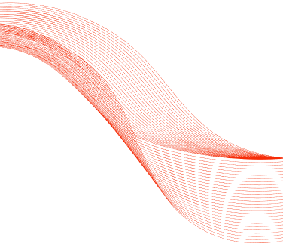
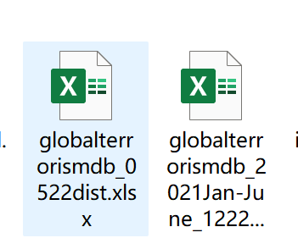
DATA PROCESSING
Data Merge & Format Conversion
Including merging two xlsx files into one and saving them in csv format
Feature Selection
Including removing features that will not be used in this project
Handle Missing Values
For some data with missing geographic attributes, we chose to delete them, and for other features with missing numerical attributes, we chose to fill them with 0.
Duplicate value processing
Removed duplicate data
Notes:
To prepare the data, I merged two separate Excel files into one CSV file, and I also removed unnecessary features that weren’t needed for the project. Also, I dealt with missing values and duplicate records. For missing geographic attributes, I chose to delete those rows, while for missing numerical values, I filled them with zeros. After removing the duplicate data, I finally created an organized dataset for visualization.

Slide 7
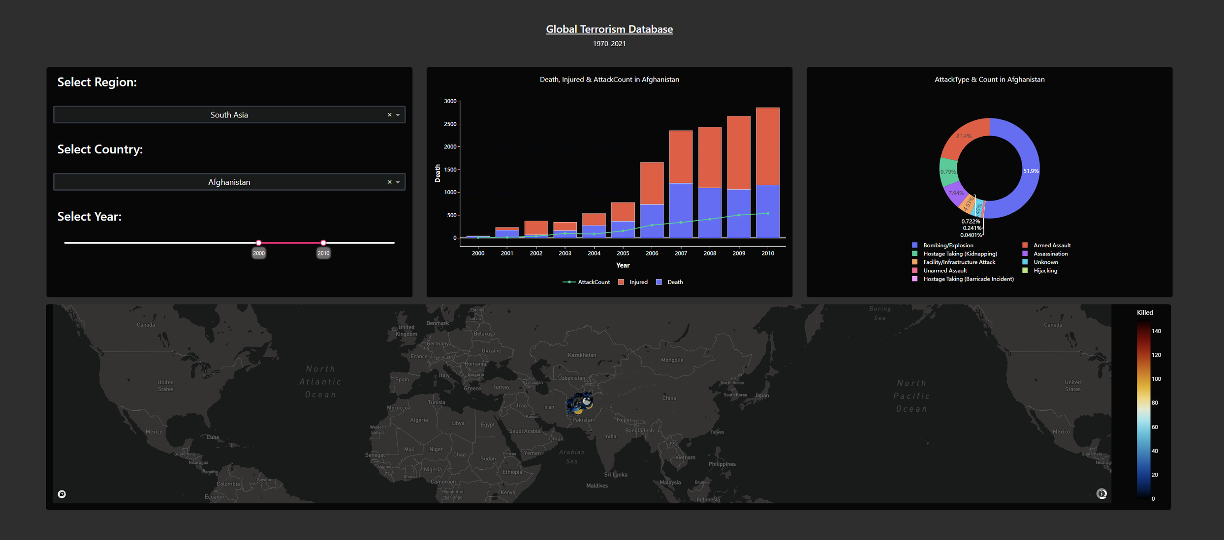
DATA VISUALIZATION
Notes:
This is my visualization page. It consists of three parts. The top part is the title, which you can click to go to the GTD official website. The middle part is composed of a filter and two charts. The bottom part is an interactive map. I will show you how to interact with it.

Slide 8
HIGHLIGHTS
My project aims to provide intuitive and easy-to-understand analytical tools for researchers, policymakers, and especially the public without background knowledge in related fields.
This research aims to develop an interactive and user-friendly data visualization platform that allows users to flexibly explore and analyze GTD data according to their needs, thereby gaining a deeper understanding of the information behind terrorism data.
Notes:
The main highlight of this project is its accessibility. My goal was to create a platform that is intuitive and easy to use for researchers, policymakers, and even the general public who might not have a background in terrorism research. The interactive and user-friendly interface enables users to explore and analyze data from the Global Terrorism Database, giving them a deeper understanding of global terrorism trends.

Slide 9
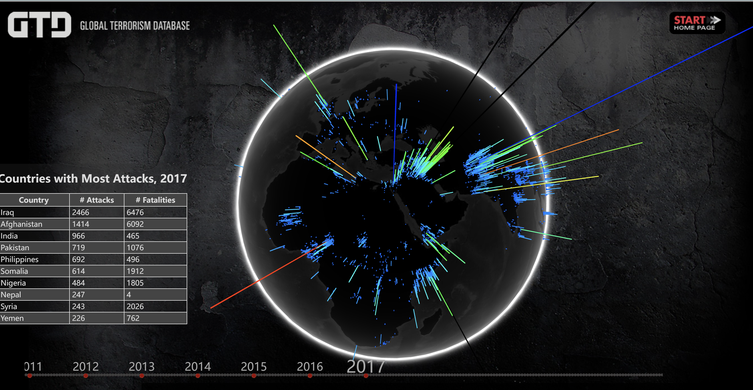
Notes:
There are indeed many similar visualizations, but they often require users to have professional background knowledge and are difficult to use.

Slide 10
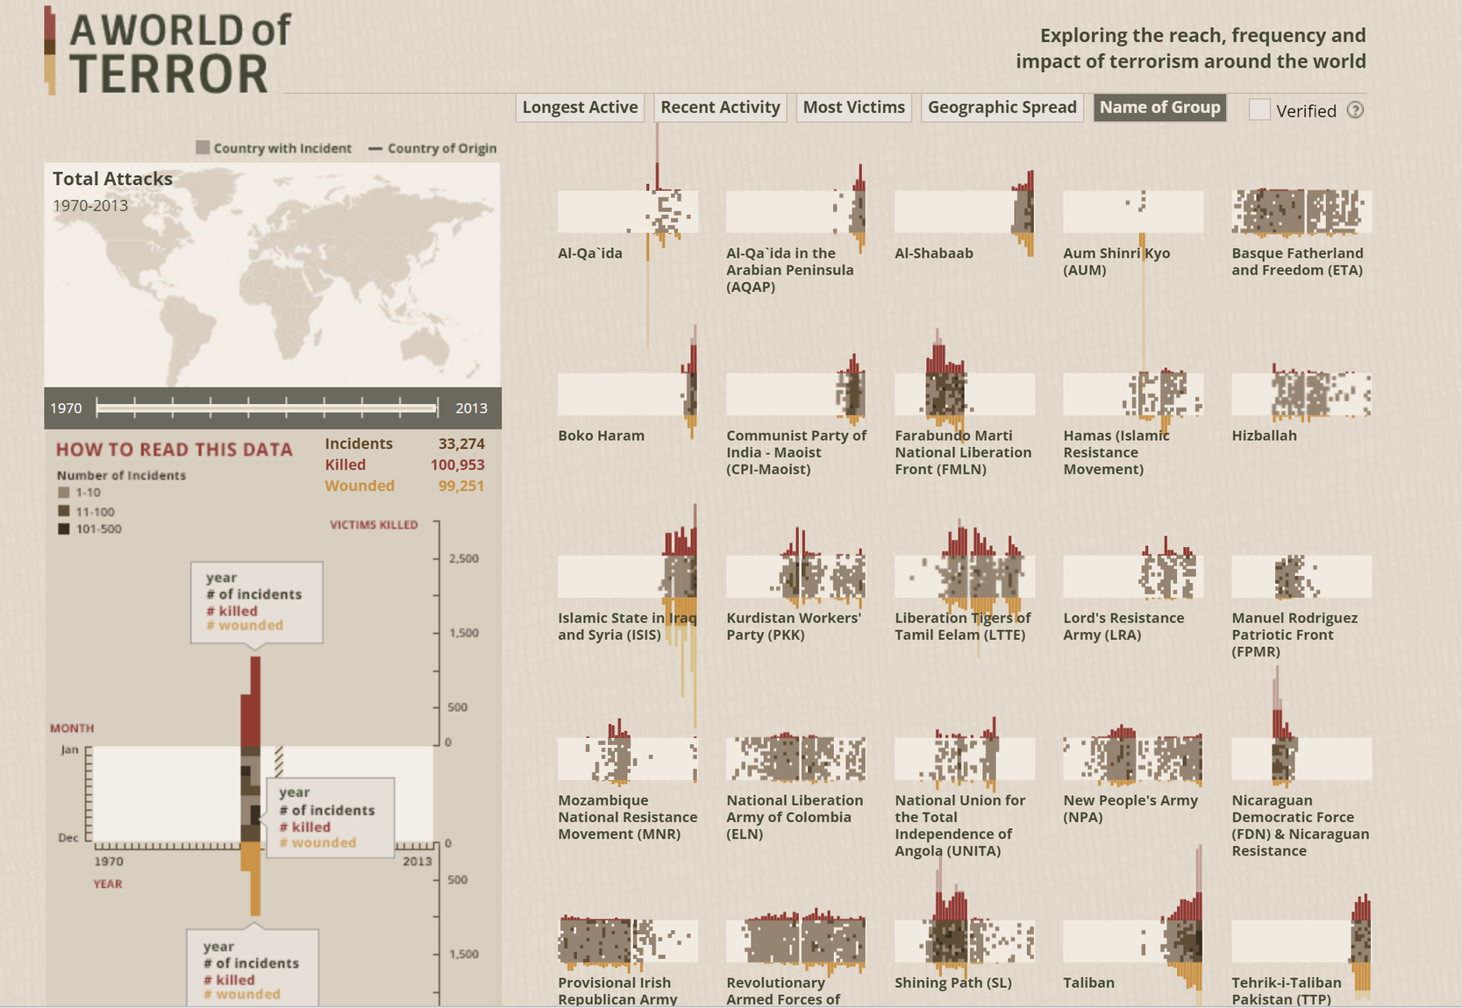
Notes:
I wish my project can empower users to explore complex data with ease, offering new insights into the dynamics of terrorism worldwide.

Slide 11
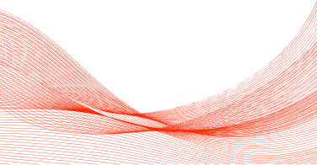
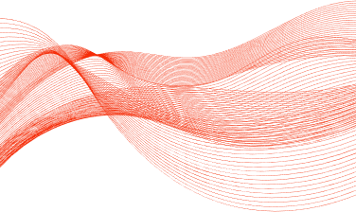
THANK U!
Feel free to ask if you have any doubt!
Notes:
Thank you for your attention. I’m happy to take any questions.

